Slide 1

(T2)Threads: Resource Sharing
Ion Mandoiu
Laurent Michel
Revised by M. Khan, J. Shi and W. Wei

Slide 2
Review
#include <pthread.h>
// Compile and link with '-pthread'
int pthread_create( pthread_t* thread, pthread_attr_t* attr, void* (*start_routine)(void*), void* arg);
// Terminating itself or return from start_routine()
void pthread_exit(void *retval);
// avoid zombie threads
int pthread_join(pthread_t thread, void ** retval);

Slide 3
Virtual Address Space
0xffffffff
Process with one thread
0x00000000

Slide 4
Virtual Address Space with Multiple threads
0xffffffff
Each thread gets a stack
Stacks have a max size -- keeps stacks separated to avoid accidental overlap
Process with three threads
Global data is shared
0x00000000

Slide 5
32-bit Implication
Virtual Address Space size on 32-bit OS
Linux: 2G
Windows: 1G
Typical stack size per thread
8 Mb
Memory usage goes to
Executable: ~ 1 to 50 Mb
Heap: ~ 1 to 200 Mb
Stacks: ~ # threads * 8 → 100 threads yield 800 Mb
Total near the limit of the address space size

Slide 6
Circumventing the limit?
Use smaller stacks!
But beware of recursion
Separate tasks in several process that
Communicate via pipes or shared virtual memory
Use a 64-bit OS
Remember 8 Mb = 2²³
Adress space size = 2⁶⁴
Executable space: no more than 1/2 !
What’s left is still 2⁶³
Enough room for 2⁴⁰ stacks!

Slide 7
Advantages of Threads
Simpler programming model
Easier to coordinate (shared address space, and data)
Lighter weight than processes
Takes less resources than process to manage
In case of substantial CPU and I/O, thread improves performance

Slide 8
Advantages of threads
Light-weight
Lower overhead for thread creation
Lower context switching overhead
Fewer OS resources
Time (sec.) for creating 50,000 processes/threads
Platform
fork()
pthread_create()
real
user
sys
real
user
sys
AMD 2.4 GHz Opteron (8cpus/node)
17.6
2.2
15.7
1.4
0.3
1.3
IBM 1.9 GHz POWER5 p5-575 (8cpus/node)
64.2
30.8
27.7
1.8
0.7
1.1
IBM 1.5 GHz POWER4 (8cpus/node)
104.1
48.6
47.2
2.0
1.0
1.5
INTEL 2.4 GHz Xeon (2 cpus/node)
55.0
1.5
20.8
1.6
0.7
0.9
The lower, the better.
INTEL 1.4 GHz Itanium2 (4 cpus/node)
54.5
1.1
22.2
2.0
1.3
0.7
https://computing.llnl.gov/tutorials/pthreads

Slide 9
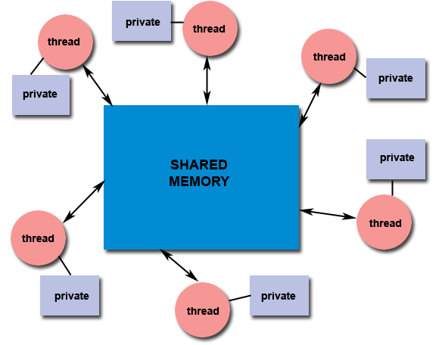
Advantages of threads
Shared State
Simpler programming model
Don’t need IPC-like mechanisms to communicate between threads
Platform | MPI Shared Memory Bandwidth (GB/sec) | Pthreads Worst Case Memory-to-CPU Bandwidth (GB/sec)
Intel 2.6 GHz Xeon E5-2670 | 4.5 | 51.2
Intel 2.8 GHz Xeon 5660 | 5.6 | 32
AMD 2.3 GHz Opteron | 1.8 | 5.3
AMD 2.4 GHz Opteron | 1.2 | 5.3
IBM 1.9 GHz POWER5 p5-575 | 4.1 | 16
IBM 1.5 GHz POWER4 | 2.1 | 4
Intel 2.4 GHz Xeon | 0.3 | 4.3
Intel 1.4 GHz Itanium 2 | 1.8 | 6.4
The larger, the better.
https://computing.llnl.gov/tutorials/pthreads

Slide 10
Shared data: global, heap, and even local
0xffffffff
int a[100];
// a, defined outside of functions,
// can be accessed in all threads.
int main(void)
{
int i; // stack
char * p = malloc(1000); // heap
void * arg = &i;
// pass p or arg to threads
}
Thread 1
Thread 2
0x00000000

Slide 11
Example: array sum
Use two threads to compute the sum of integers in an array

Slide 12
Disadvantages of threads: What if…
A thread does something stupid like
A division by zero?
Dereferencing a null pointer ?
Corrupting a block of memory ?
Access a bad file descriptor ?
The entire process crashes and burns!

Slide 13
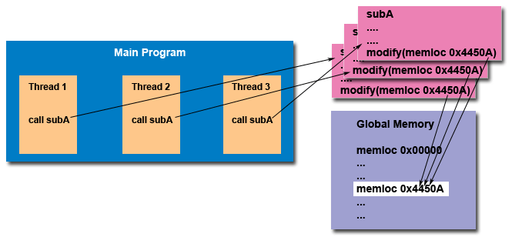
Disadvantages of threads: Shared State
You may not be aware of shared resources!
https://computing.llnl.gov/tutorials/pthreads

Slide 14
However, Sharing is Unsafe A simple counting program…
#include <stdio.h>
#include <stdlib.h>
#include <pthread.h>
long count = 0;
void* increase(void *arg){
long i, inc = *(long *)arg;
for (i=0; i<inc; i++)
count++;
pthread_exit(NULL);
}
int main(int argc, char* argv[]){
pthread_t tid1, tid2;
long inc = atol(argc >= 2 ? argv[1] : "100");
pthread_create(&tid1, NULL, increase, &inc);
pthread_create(&tid2, NULL, increase, &inc);
pthread_join(tid1, NULL);
pthread_join(tid2, NULL);
printf("counter is %ld\n", count);
return 0;
}

Slide 15
Example
Consider two threads each doing the following
int x = 0;
void increase(int cnt) {
int i;
for(i=0;i<cnt;i++)
x = x + 1;
}
void increase(int cnt) {
int i;
for(i=0;i<cnt;i++)
x = x + 1;
}
What will happen ?

Slide 16
What is happening?
The addition
Becomes more complex in assembly
Something like (pseudo-code)
void increase(int cnt) {
int i;
for(i=0;i<cnt;i++)
x = x + 1;
}
// x = x + 1;
LOAD RAX, &x
ADD RAX, 1
STORE RAX, &x

Slide 17
What is happening?
Threads execute this concurrently
Even on a single core, the execution of a thread can be interrupted
// x = x + 1;
LOAD RAX, &x
ADD RAX, 1
STORE RAX, &x
T1
T2
LOAD RAX, &x
ADD RAX, 1
STORE RAX, &x
context
switching
LOAD RAX, &x
ADD RAX, 1
STORE RAX, &x
…
Notes:
Demo!

Slide 18
Lesson
Even sharing a single integer can go wrong!
What to do ?
We need coordinations!
RULES and PROTOCOLS
To establish how to share data safely and keep everyone happy
Remember the lesson!
Notes:
We make a lot of mistakes when accessing shared resources

Slide 19
The Road Ahead
What we will do
Define PROTOCOLS and DATA STRUCTURES to safely share
Examples
Mutexes / Spinlocks
Conditions
Semaphores
Barriers
Producer / Consumer
Reader / Writer
…

Slide 20
How unsafe can this be ?
Lots of subtle issues
It is very easy to get it wrong.
Good multi-threading programming must be disciplined
Good code
Good practice
Good synchronization
Low overhead

Slide 21
Study the remaining slides yourself

Slide 22
Detaching a thread
int pthread_detach(pthread_t tid)
The "parent" thread doesn’t need to wait
A thread can detach another thread
When a detached thread terminates, its resources are automatically released
A thread can detach itself:
pthread_detach(pthread_self());
Only threads created as joinable and not detached can be joined

Slide 23
Passing Arguments to Threads - 1
#include <pthread.h>
#include <stdio.h>
#include <stdlib.h>
#include <unistd.h>
#include <string.h>
#define NUM_THREADS 8
struct thread_data {
int thread_num;
char* message;
};
void* PrintHello(void* threadarg) {
struct thread_data* my_data = (struct thread_data*) threadarg;
sleep(1 + 5*(my_data->thread_num % 2) );
printf("Thread #%d: %s length=%zd\n", my_data->thread_num, my_data->message, strlen(my_data->message));
pthread_exit(NULL);
}

Slide 24
Passing Arguments to Threads - 2
int main(int argc, char* argv[])
{
pthread_t threads[NUM_THREADS];
static struct thread_data thread_data_array[NUM_THREADS];
char* messages[NUM_THREADS];
int rc, t;
messages[0] = "English: Hello World!";
messages[1] = "French: Bonjour, le monde!";
messages[2] = "Spanish: Hola al mundo";
messages[3] = "Klingon: Nuq neH!";
messages[4] = "German: Guten Tag, Welt!";
messages[5] = "Russian: Zdravstvuyte, mir!";
messages[6] = "Japan: Sekai e konnichiwa!";
messages[7] = "Latin: Orbis, te saluto!";
// continue on the next slide

Slide 25
Passing Arguments to Threads - 3
for( t=0; t<NUM_THREADS; t++ ) {
//set up struct for thread t
thread_data_array[t].thread_num = t;
thread_data_array[t].message = messages[t];
printf("Creating thread #%d\n", t);
rc = pthread_create(&threads[t], NULL, PrintHello,
(void*)&thread_data_array[t]);
if (rc) {
printf("ERROR; return code from pthread_create() is %d\n", rc);
exit(-1);
}
printf("Detaching thread #%d\n", t);
rc = pthread_detach( threads[t] ); // detach a thread
if( rc ){
printf("ERROR; return code from pthread_detach() is %d\n", rc);
exit(-1);
}
}
pthread_exit(NULL);
}

Slide 26
Create a thread as detached
When calling pthread_create(), one of the attributes defines whether the thread is joinable or detached
By default (NULL attribute) threads are created as joinable
pthread_t tid; void * arg; // thread id and argument
pthread_attr_t attr; // an attribute variable
pthread_attr_init(&tattr); // initialize with default attributes
// set detach state
pthread_attr_setdetachstate(&tattr, PTHREAD_CREATE_DETACHED);
pthread_create(&tid, &tattr, start_routine, arg); // create thread
pthread_attr_destroy(&attr); // destroy the attribute

Slide 27
Explicitly create a thread as detached
Use the attr argument in pthread_create()
4 step process:
Declare a pthread attribute variable of the pthread_attr_t data type
Initialize the attribute variable with pthread_attr_init()
Set the attribute detached status with pthread_attr_setdetachstate()
When done, free library resources used by the attribute with pthread_attr_destroy()

